Slide 1
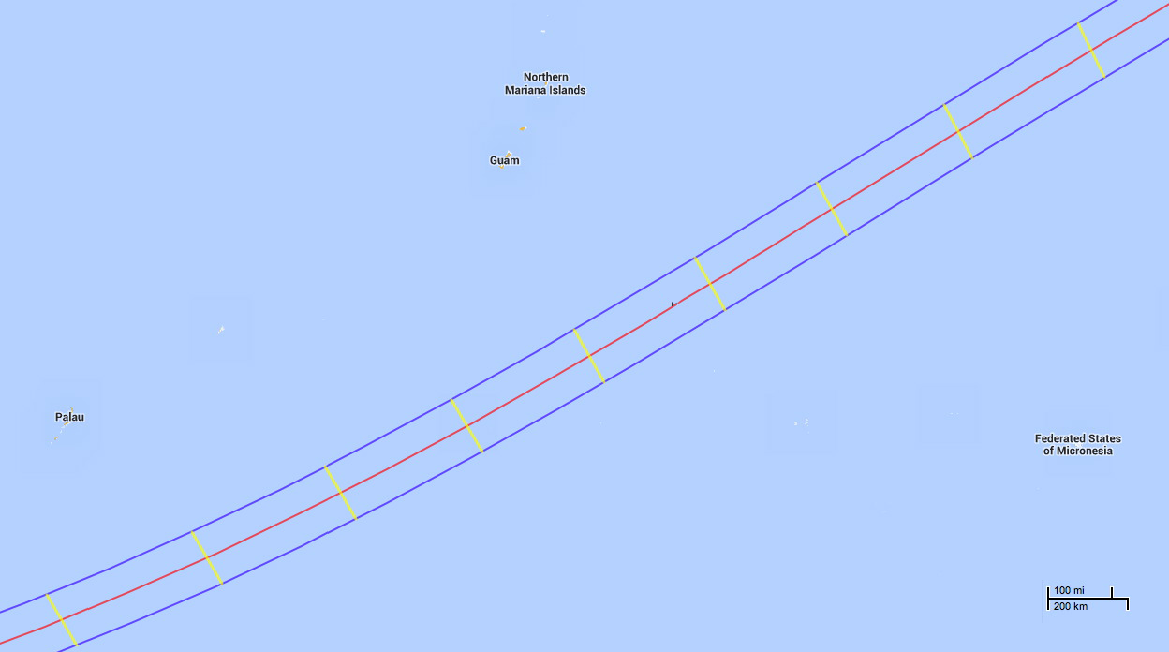
Closest CL Point
10° 49.8’ N, 149° 58.3’ E
02h 01m 22s UTC
Duration: 4m 09s
Greatest Duration
10° 04’N, 148° 42’E
01h 56m 52s
Furation: 04m 09.4s
230 nm
Chuuk (Weno)
07° 27.7’ N, 151° 50.6’ E

