Slide 1
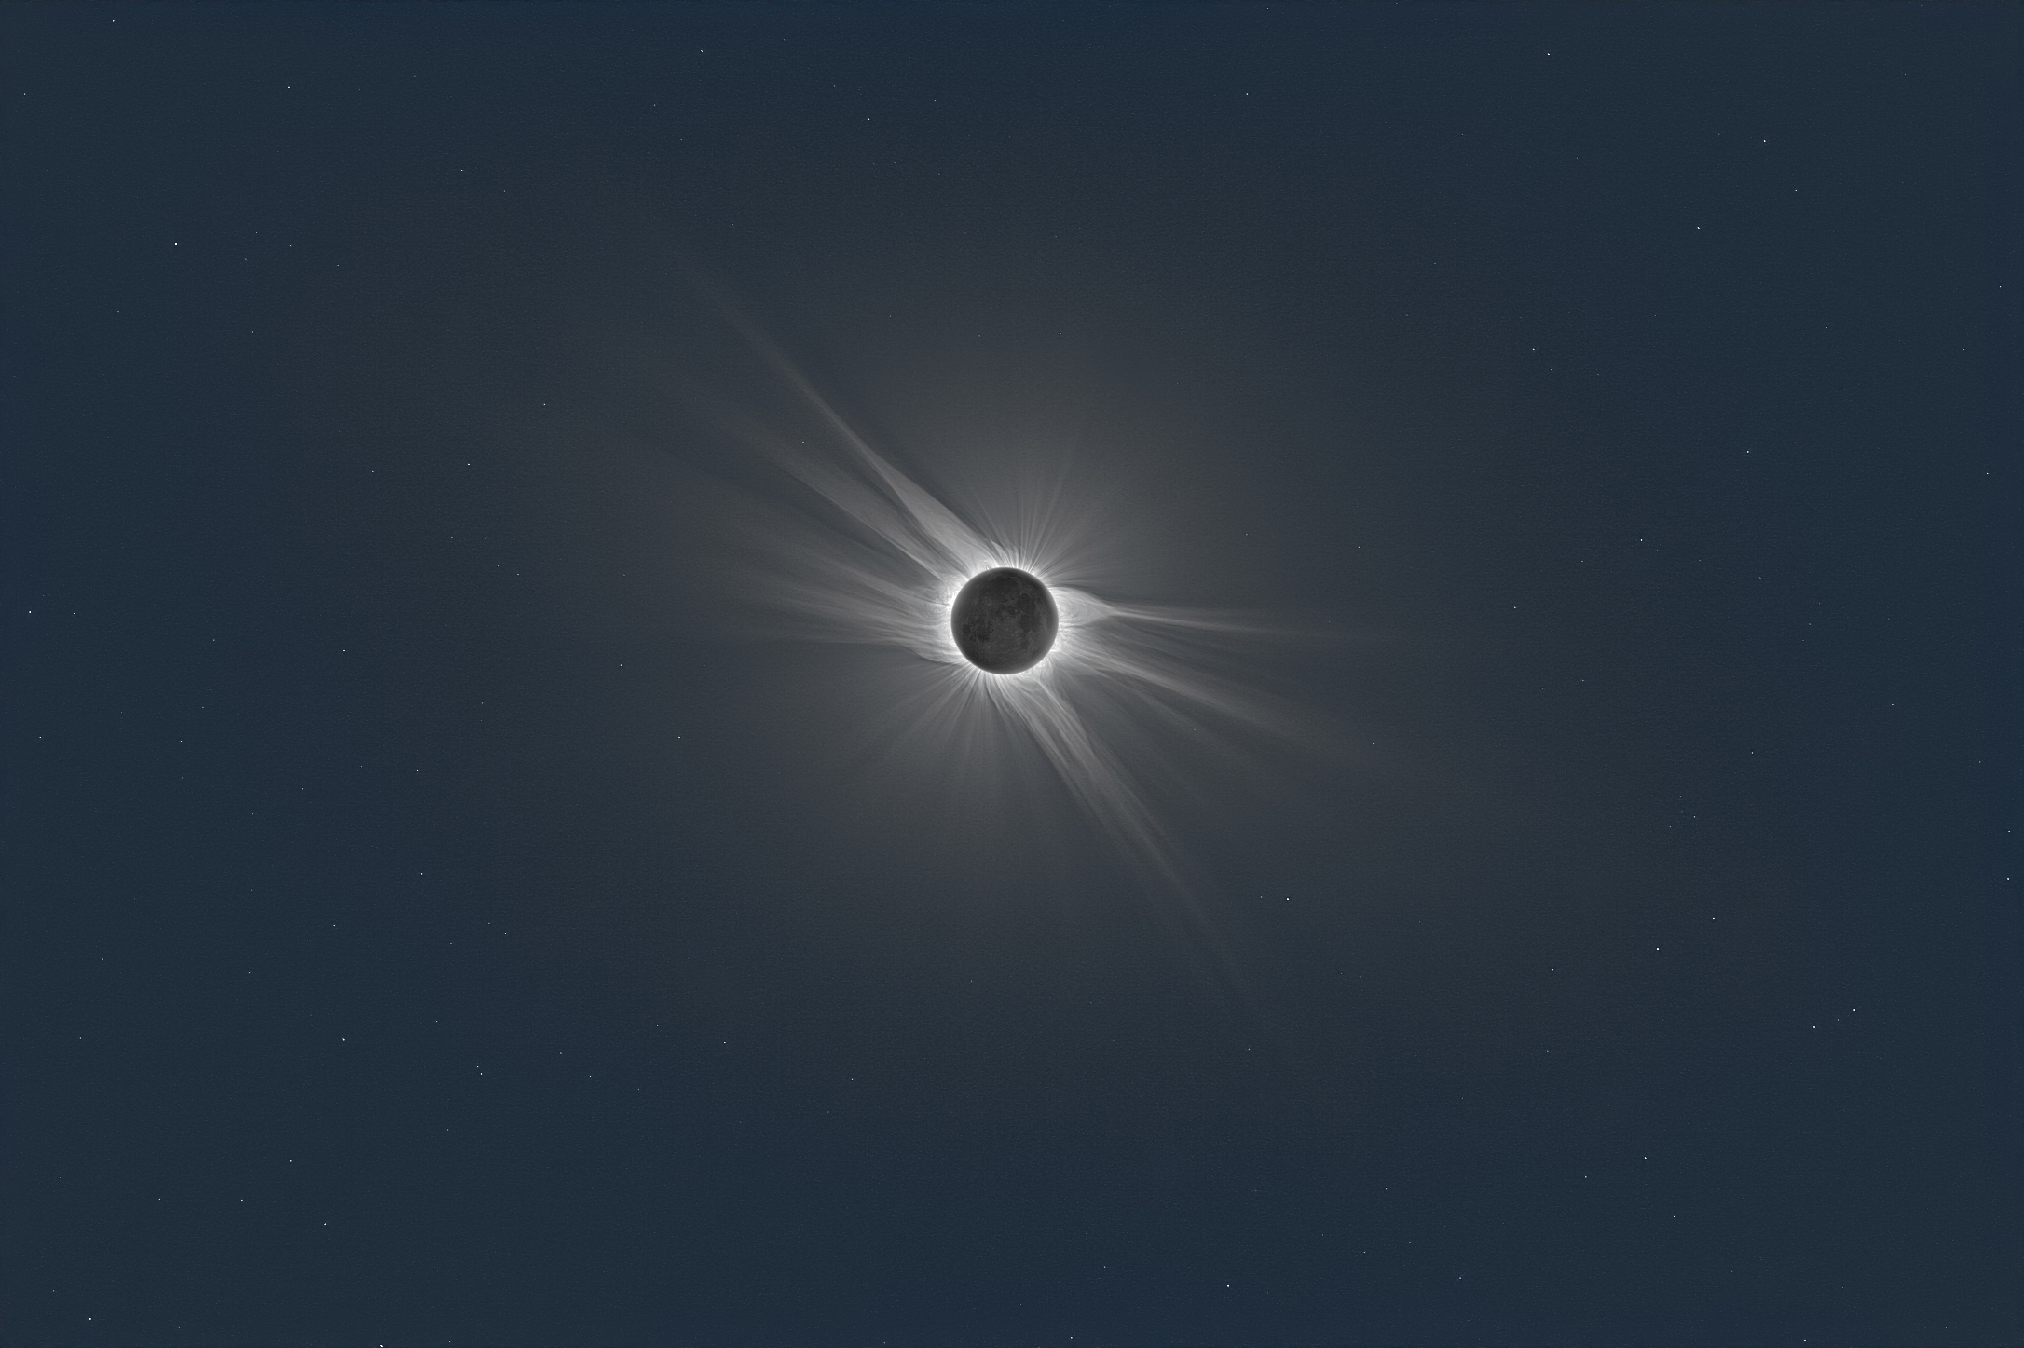
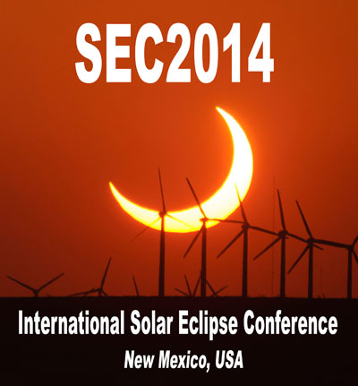
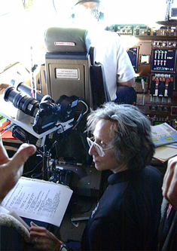
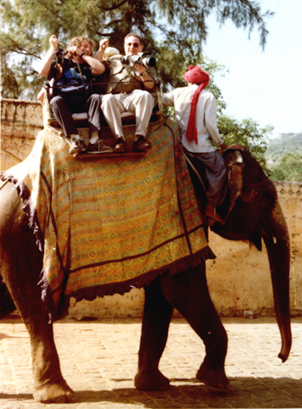
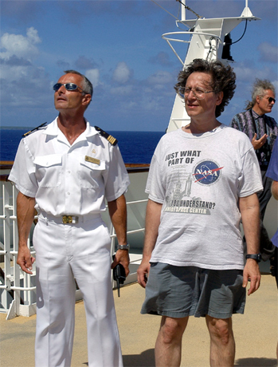
Umbraphilic Esoterica: A Retrospective Beyond Science & Technology
WARNING: Eclipse
chasing is addictive.
There is no cure.
Dr. Glenn Schneider
Steward Observatory, University of Arizona
Tucson, Arizona 85721 USA
center image by M. Druckmuller

Slide 2
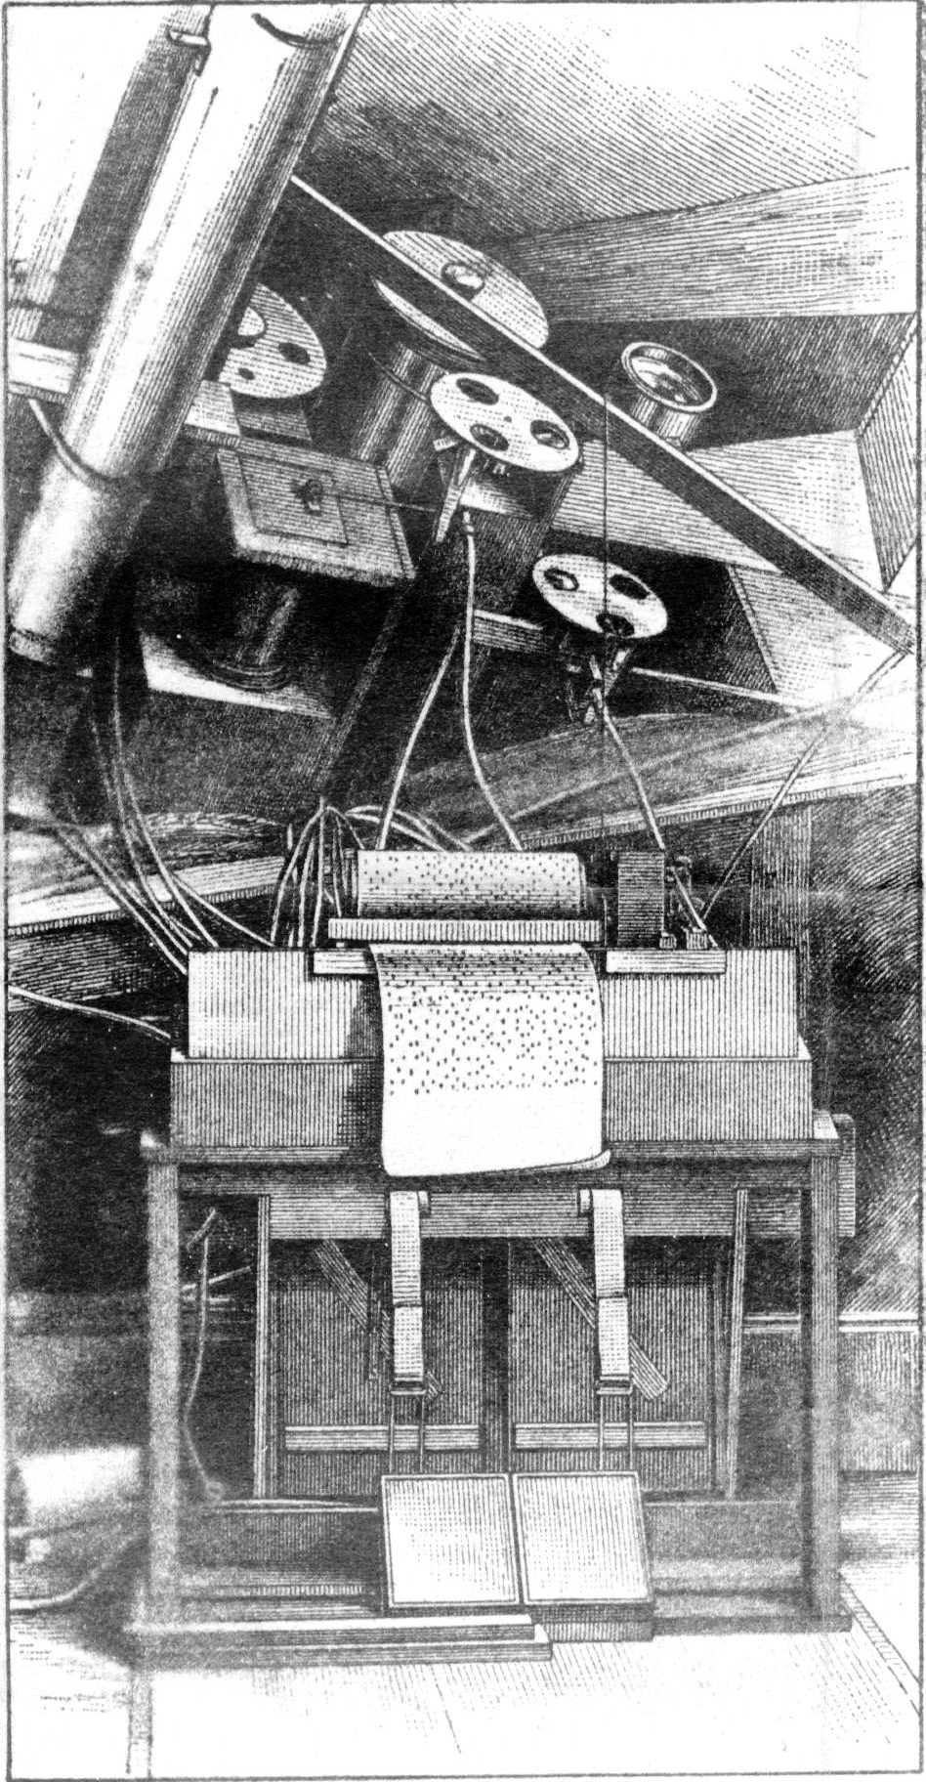
This talk is dedicated to the memory of
Prof. David Peck Todd
(1855 – 1939)
The Eclipse-Chaser’s Eclipse-Chaser
and inventor of
Automatic Eclipse Photography
and
Radial Gradient (coronal) Imaging
(and much more…)

Slide 3
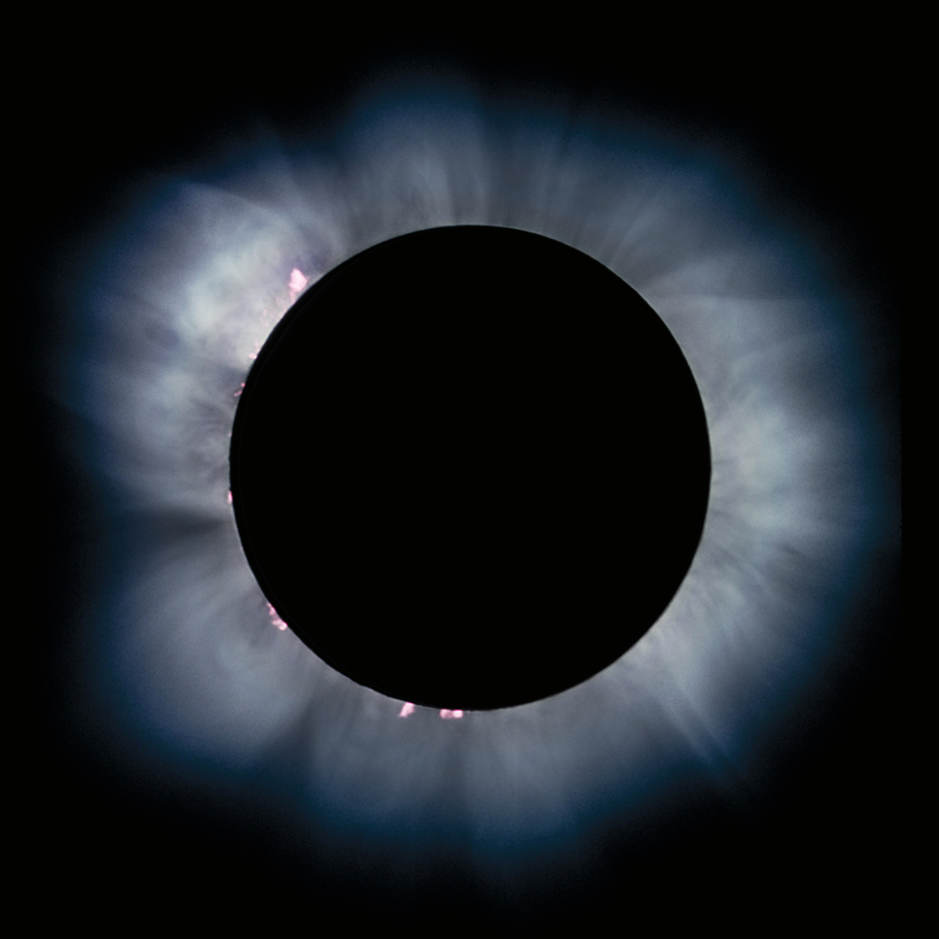
Science aside… A TOTAL Solar Eclipse is arguably THE most impressive and awe inspiring re-occurring natural phenomenon that humans can witness

Slide 4
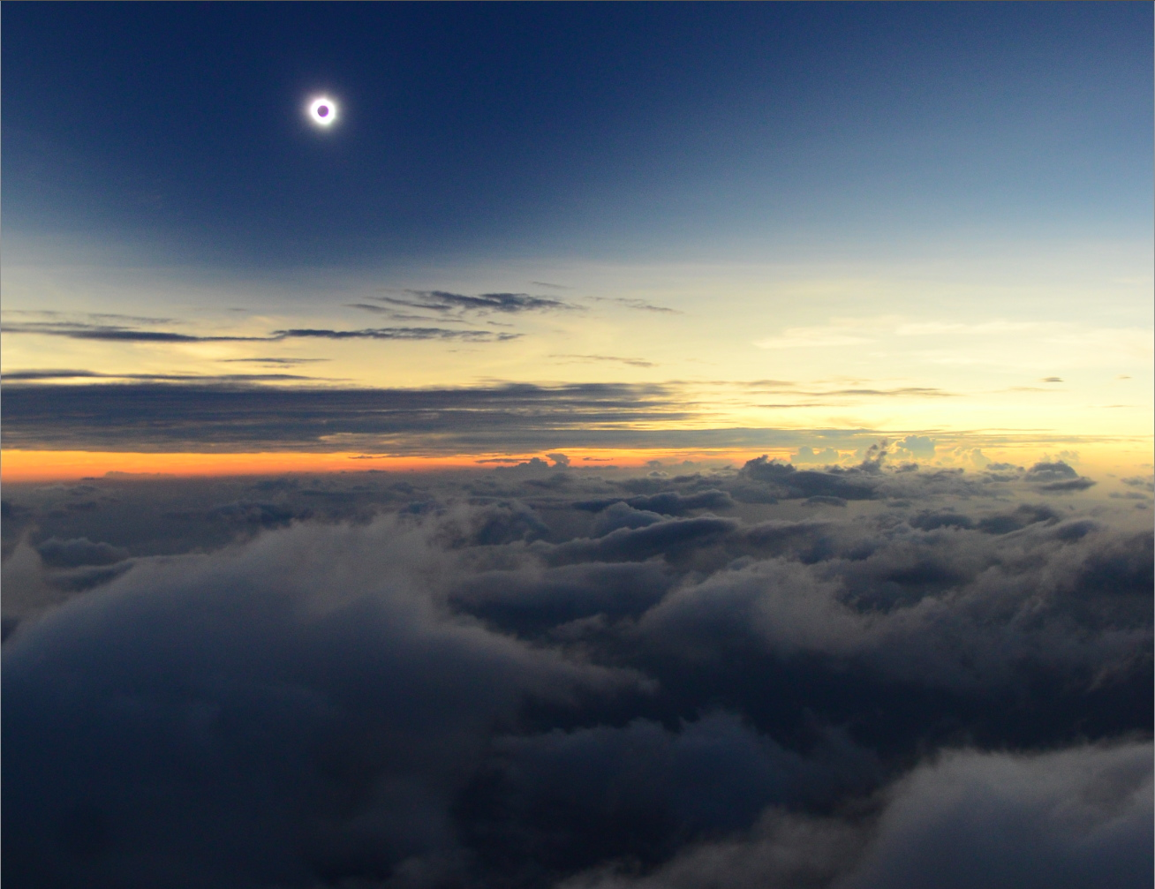
The MOST Viscerally Dramatic
And Dynamic of ALL Celestial
Shadow Events

Slide 5
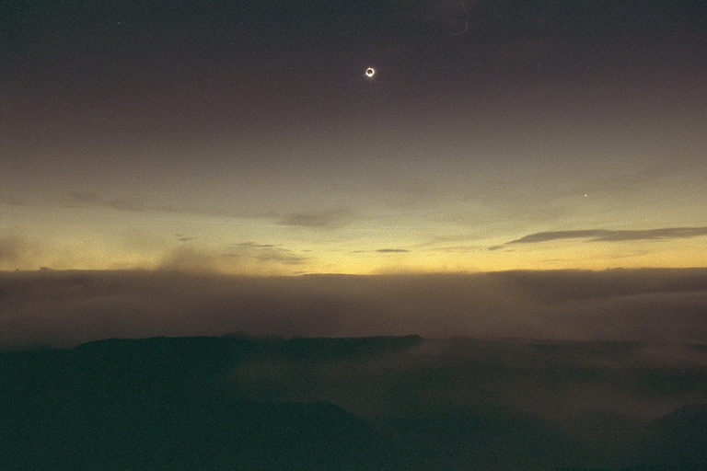
Ominous Beginnings
Umbraphobia
Total Solar Eclipses in Antiquity
• Universally Regarded as Portents of Dark Times
• Trans-culturally perceived as fearsome phenomenon
• “Predicted” to be forewarned not welcomed!
Intentionally “Chasing” the Moon’s shadow INTO the “path of totality” is a relatively new endeavor in the course of human history.

Slide 6
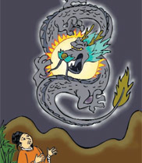
Ominous Beginnings: Most Oft-Cited and Best-Known Examples
22 October 2134 B.C.
Pre-Xia dynastic ancient China
(period of 3 sovereigns & 5 emperors)
Tale of two court astrologers (Hi and
Ho) who were purportedly beheaded
for failing to predict a total solar eclipse.
Epitaph of Hi and Ho:
“Here lie the bodies of Ho and Hi,
Whose fate, though sad, is risible;
Being slain because they could not spy
Th' eclipse which was invisible.”
- author unknown

Slide 7
Ominous Beginnings: Most Oft-Cited and Best-Known Examples
28 May 585 B.C.
The Battle of Halys (Lydian/Median war).
“A battle took place in which it happened… that suddenly the day became night. And this change of the day Thales the Milesian had foretold to the Ionians… The Lydians however and the Medes, when they saw that it had become night instead of day, ceased from their fighting and were much more eager both of them that peace should be made between them.”
– Herodotus of Halicarnassus

Slide 8
Ominous Beginnings: Most Oft-Cited and Best-Known Examples
From the Book of Amos (Chapter 8):
9. And it shall come to pass in that day, saith the Lord GOD, that I will cause the sun to go down at noon, and I will darken the earth in the clear day:
10. And I will turn your feasts into mourning, and all your songs into lamentation; and I will bring up sackcloth upon all loins, and baldness upon every head; and I will make it as the mourning of an only son, and the end thereof as a bitter day.

Slide 9
Enlightenment in the
Darkness of the Lunar Umbra
But
Things Don’t Always
Go As Planned…
(the “early” days of eclipse chasing)

Slide 10
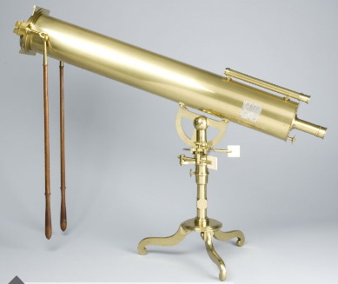
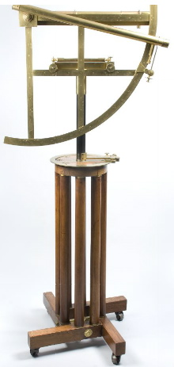
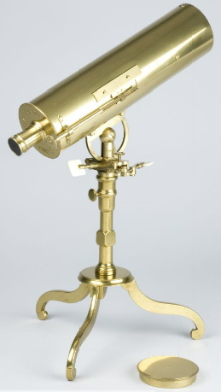
Intentionally “Chasing” the Moon’s shadow INTO the “path of totality” is a relatively new endeavor in the course of human history.
27 October 1780 AD – “Long Island”, Penobscot Bay, Maine
HARVARD COLLEGE EXPEDITION
• Behind Enemy Lines During
American Revolutionary War
• Eclipse path & circumstances
calculated by Prof Samuel Williams
• Expedition financed by Board of War
• General court of Mass. Provided
a State Galley (ship) for transport
• Instrumentation*: Multiple telescopes,
chronometer, micrometer,
thermometer…
*preserved in the Collection of Historical Scientific Instruments – Harvard University

Slide 11
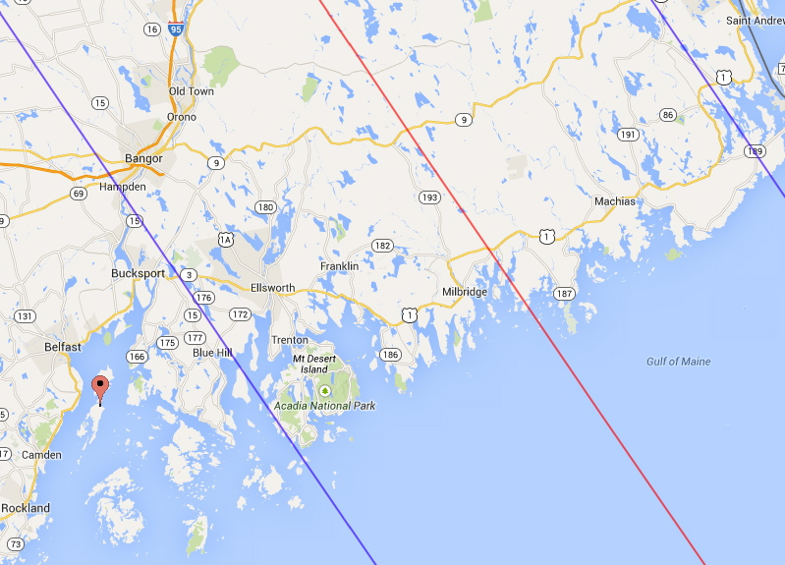
Intentionally “Chasing” the Moon’s shadow INTO the “path of totality” is a relatively new endeavor in the course of human history.
27 October 1780 AD – “Long Island”, Penobscot Bay, Maine
MISCALCULATED! - Outside Path of Totality
Iseslborough
“Long Island”
Penobscot Bay
Maine
max eclipse: 16:49:42 UTC
max obscuration: 99.6%
max magnitude: 0.994
centerline
southern limit
"Eclipse Predictions by Fred Espenak (NASA's GSFC)"

Slide 12
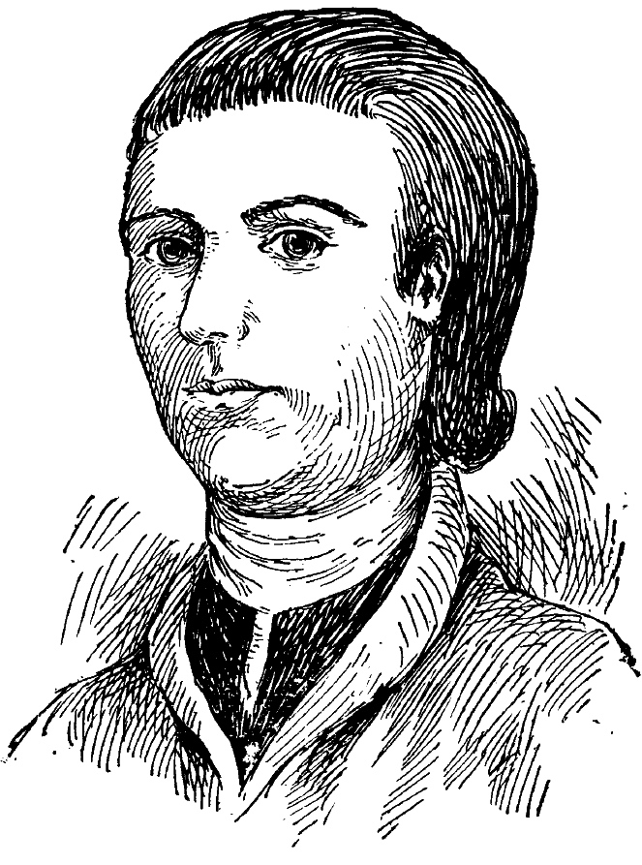
Intentionally “Chasing” the Moon’s shadow INTO the “path of totality” is a relatively new endeavor in the course of human history.
27 October 1780 AD – “Long Island”, Maine
“The greatest obscuration was at 12 hours, 30 degrees 12 minutes {?}, at which time the sun’s limb was reduced to so fine a thread, and so much broken, as to be incapable of mensuration…
Samuel Williams
“From the beginning of the eclipse unto the time of the greatest obscuration, the color and appearance of the sky was gradually changing from an azure blue to a more dark or dusky color, until it bore the appearance and gloom of night. To this we may add, so unusual a darkness, dampness and chill, in the midst of day, seemed to spread a general amazement among all sorts of animals. Nor could we ourselves observe such unusual phenomena without some disagreeable feelings.”.
Samuel Williams, "Observations of a solar eclipse, October 27, 1780, made on the east side of Long
Island, in Penobscot-Bay,” Memoirs of the American Academy of Arts and Sciences 1 (1785): 86-102.

Slide 13
Enlightenment in the
Darkness of the Lunar Umbra
The Age of
Eclipse Photography
1851 — …

Slide 14
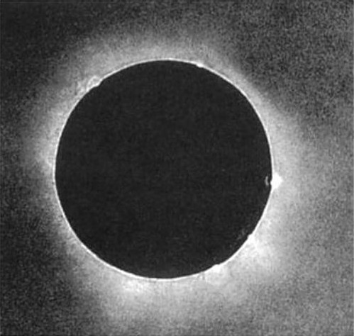
28 July 1851 (Konigsberg)
The Berkowski
Daguerreotype
• The 1st known “correctly expo-
sed*” photograph (daguer-
re-otype) of the solar corona
• Single 84-second exposure
• D = 6.1 cm f/13.3 refractor on a clock driven mount
• Original plate: D_{moon} = 7.9 mm
• (Well) recorded corona and
five prominences
But, for decades still to follow, sketches
would continue to “compete” with
fledgling photographic technologies.
*Schielicke & Whitman, Acta Historia Astronomiae, 25, 128 (2005)

Slide 15
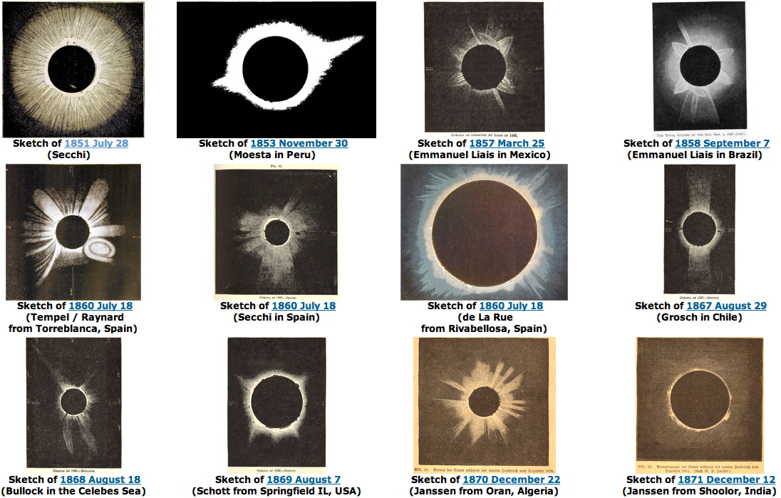
Representative coronal sketches following the 1851 TSE daguerrotype
Images collected by X. Jubier: http://xjubier.free.fr/en/site_pages/solar_eclipses/Solar_Corona_Shape_pg01.html

Slide 16
Enlightenment in the
Darkness of the Lunar Umbra
The Age of
Eclipse Spectroscopy
1868 — …

Slide 17
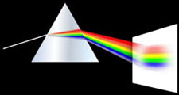
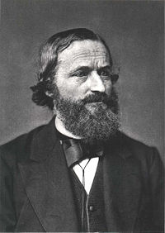
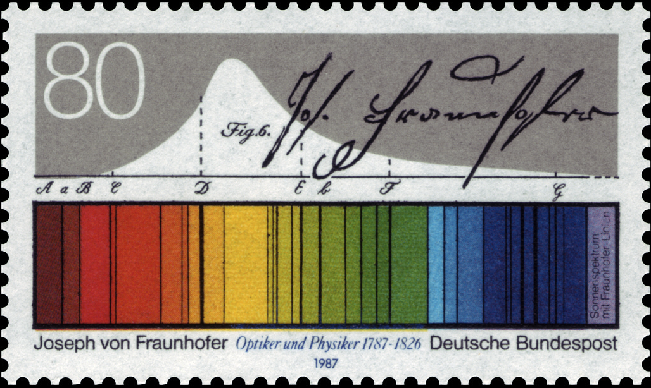
Intentionally “Chasing” the Moon’s shadow INTO the “path of totality” is a relatively new endeavor in the course of human history.
The “Golden Age” of the Late 19th Century Professional Expeditions
gas
G. Kirchoff
1824 - 1887
In 1858 Gustov Kirchoff theorized that “Fraunhoffer lines” seen in the solar spectrum were fingerprints of chemical elements in the Sun.

Slide 18
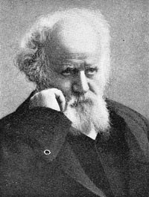
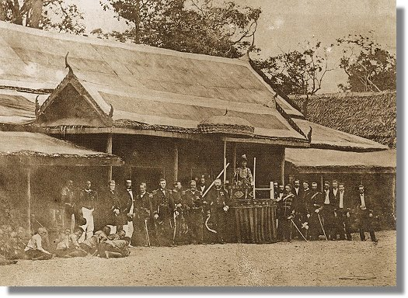
Intentionally “Chasing” the Moon’s shadow INTO the “path of totality” is a relatively new endeavor in the course of human history.
The “Golden Age” of the Late 19th Century Professional Expeditions
18 August 1868 Guntoor, India
Observed by Jules Janssen with a spectroscope.
Goal: To study the nature of solar prominences.
• Spectroscopically identified super-hot Hydrogen
but also…
• a NEW chemical element then known on Earth:
“Coronium” (later “Helium” for the Sun God Helios).
(P.) J. Janssen
1824 – 19XX
Later (1895) identified on Earth as
emanating from Uranium ore.
Today we know He on the Sun is
Created by “nucleosynthesis”: H->He
On Earth by nuclear decay. E.g.,
Uranium 238 → Thorium 234 + He 4
British/French TSE 1868 expedition to
Thailand invited by King Rama IV

Slide 19
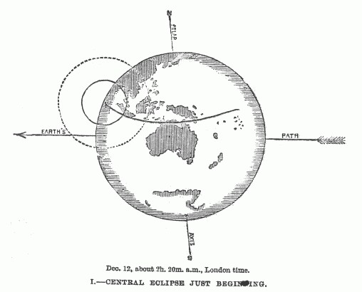
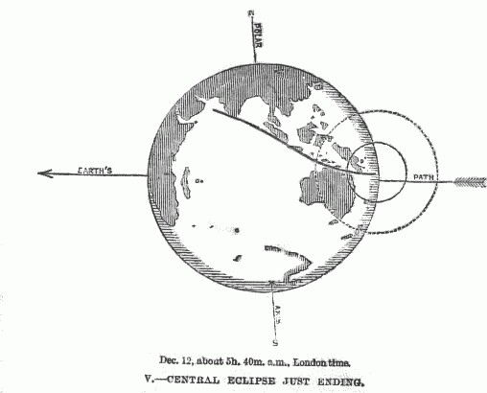
Intentionally “Chasing” the Moon’s shadow INTO the “path of totality” is a relatively new endeavor in the course of human history.
The “Golden Age” of the Late 19th Century Professional Expeditions
12 December 1871
International Deployments to Ceylon, India, Java, and Austalia to allow intercomparison of observations with similar instruments

Slide 20
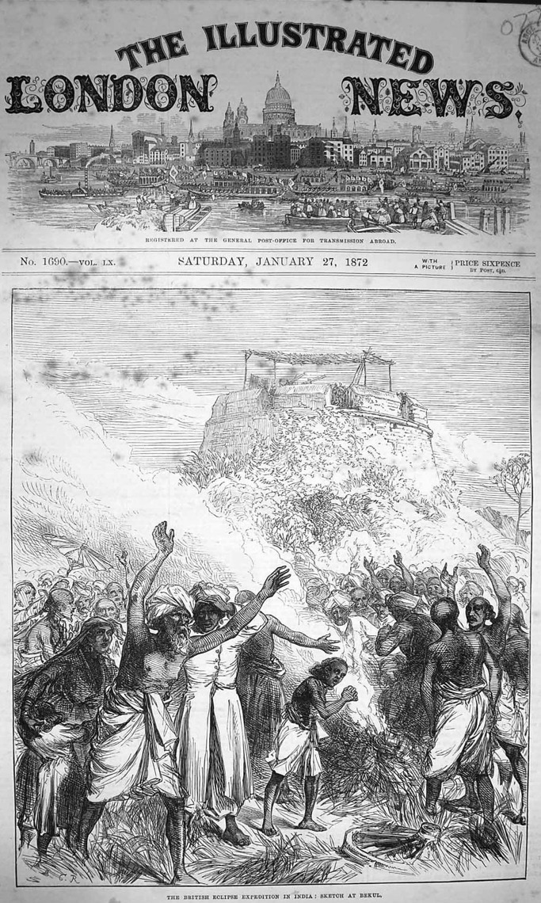
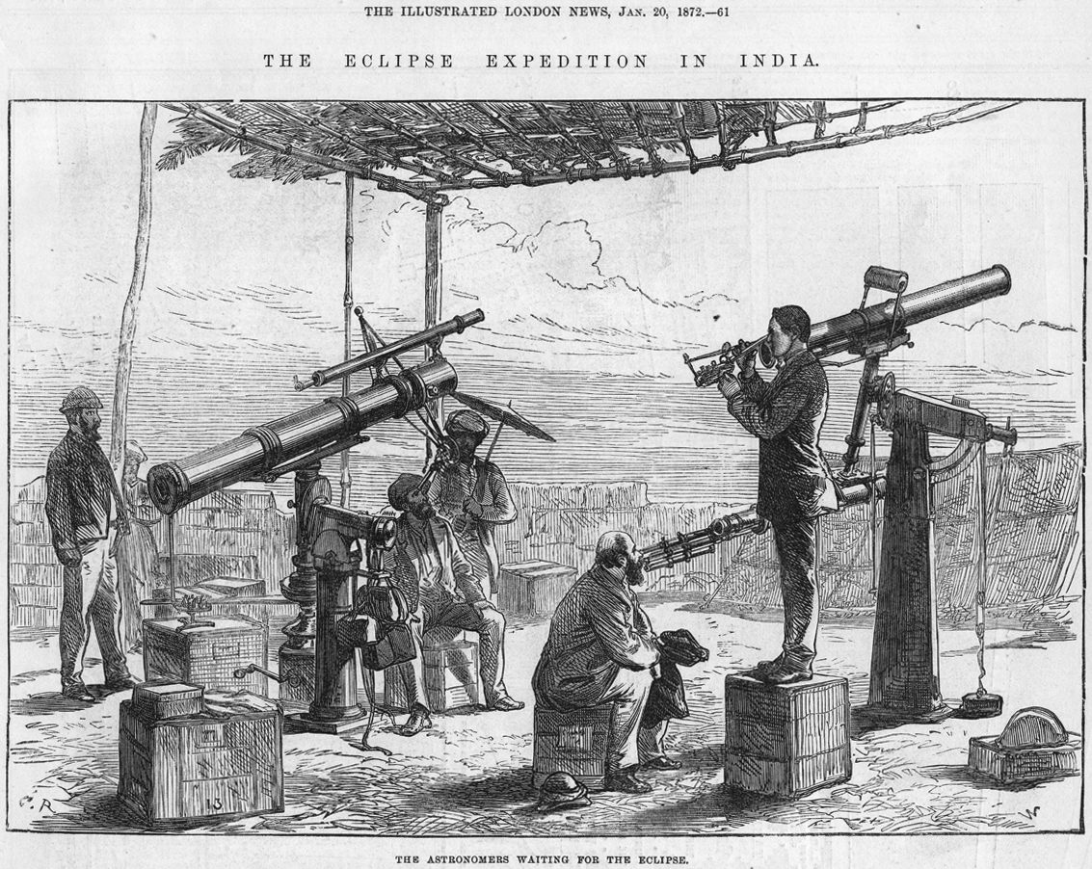
Intentionally “Chasing” the Moon’s shadow INTO the “path of totality” is a relatively new endeavor in the course of human history.
The “Golden Age” of the Late 19th Century Professional Expeditions
12 December 1871 – British Eclipse Expedition to India

Slide 21
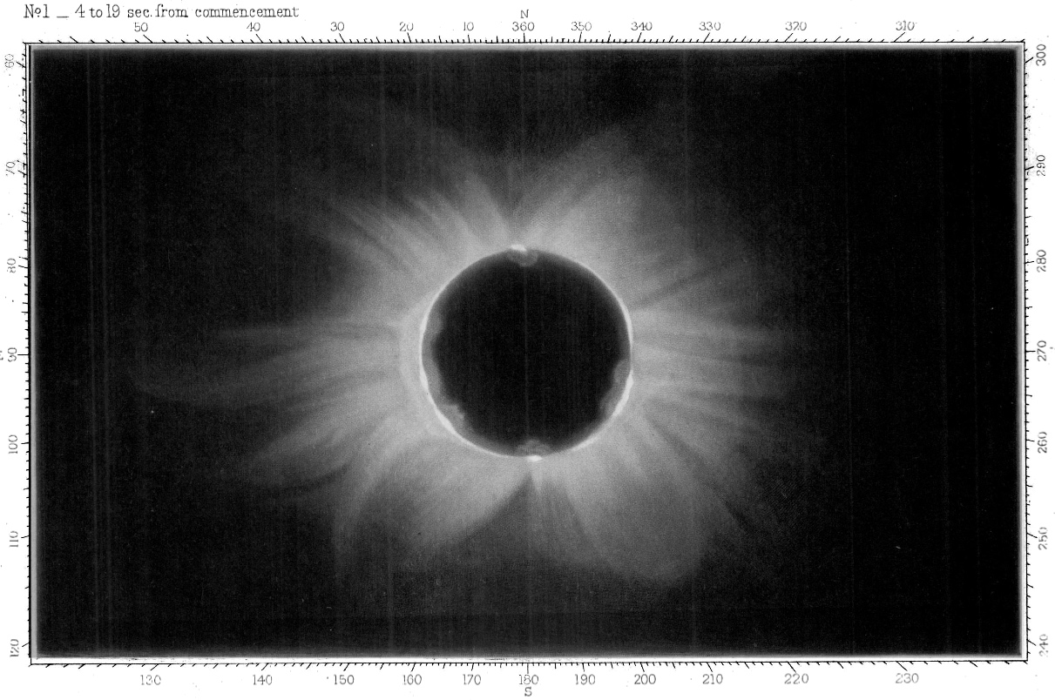
Report on TSE 1871 from Dodabetta, India (2m 08s totality)
One of 6 plates obtained. 15s exp soon after CII. D = 4”, f/8.3
“The developer had
the following
constitution:
Ferrous Sulphate
Table Sugar
Glacial acetic acid
Spirit of wine”
J. F. Tennant, MmRAS, 41, 1 (1875)
(Contemporary Umbraphiles Would Return to Cape York for TSE 2012 )

Slide 22
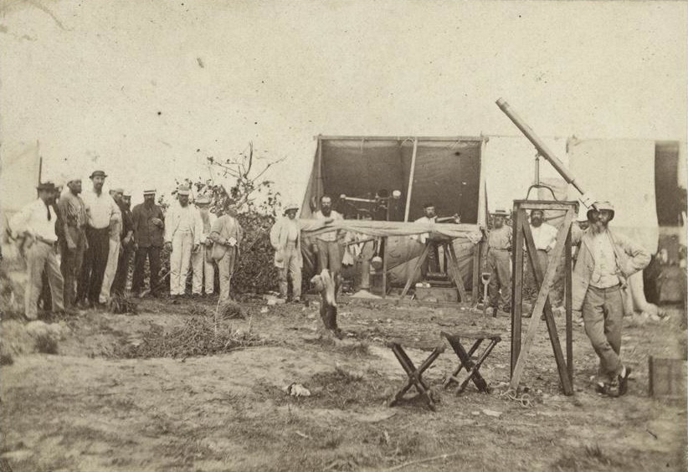
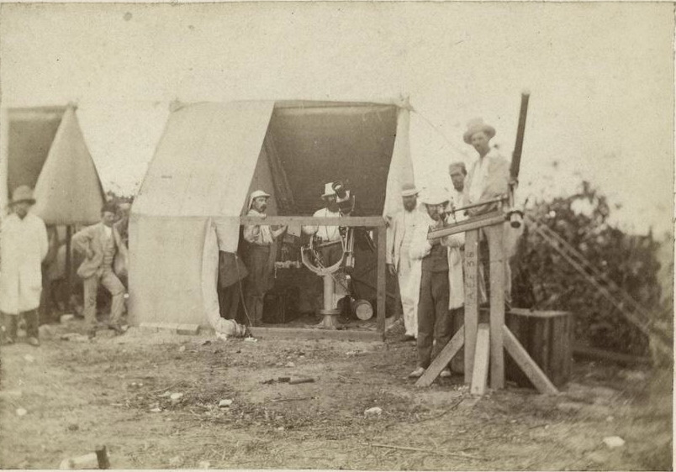
Intentionally “Chasing” the Moon’s shadow INTO the “path of totality” is a relatively new endeavor in the course of human history.
The “Golden Age” of the Late 19th Century Professional Expeditions
12 December 1871 – Cape York, Queensland* (Royal Society Victoria)
(Contemporary Umbraphiles Would Return to Cape York for TSE 2012 )

Slide 23
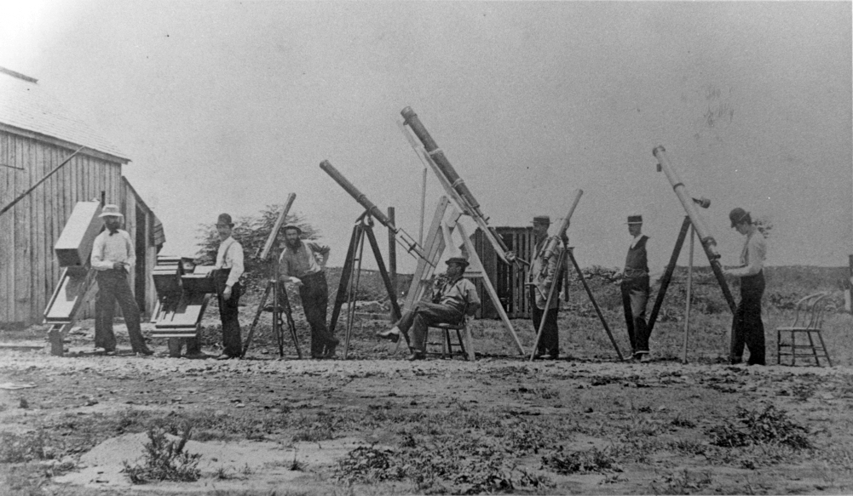
29 July 1878 – Fort Worth, Texas USA (near today’s DFW airport)
The “Fort Worth Eclipse Party” … “recording such phenomena as might aid in establishing the correct theory of the corona … seen surrounding the sun during the moments of total solar eclipse”.
Notes:
http://books.google.com/books?id=cE3nAAAAMAAJ&printsec=frontcover&dq=1878+solar+eclipse&source=bl&ots=XbH6L3C8zj&sig=50vI_1mhsuj7SeYrZ03OvrqUcvs&hl=en&ei=Ag21S4-ME4T58Abe_4xl&sa=X&oi=book_result&ct=result&resnum=6&ved=0CBEQ6AEwBQ#v=onepage&q&f=false

Slide 24
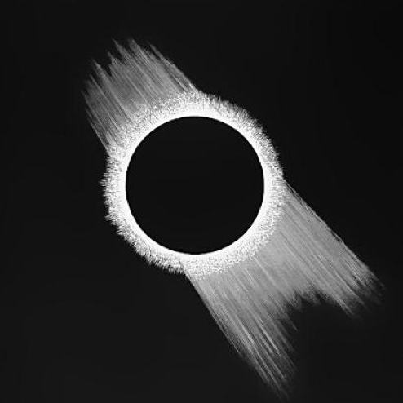
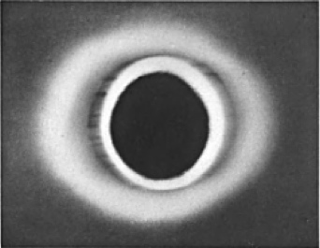
29 July 1878 – Fort Worth, Texas USA (near today’s DFW airport)
The “Fort Worth Eclipse Party” … “recording such phenomena as might aid in establishing the correct theory of the corona … seen surrounding the sun during the moments of total solar eclipse”.
Naked-eye view of the corona drawn by Prof. S. H. Lockett
Best of three photographic images obtained (48” EFL, 17s exp) by Leonard Waldo
photography was still challenging!
“Report of Observations Made of the Total Solar Eclipse, July 29, 1878, Made at Fort Worth, Texas, ed. Leonard Waldo, Cambridge: Press of John Wilson and Son (1879)
Notes:
http://books.google.com/books?id=cE3nAAAAMAAJ&printsec=frontcover&dq=1878+solar+eclipse&source=bl&ots=XbH6L3C8zj&sig=50vI_1mhsuj7SeYrZ03OvrqUcvs&hl=en&ei=Ag21S4-ME4T58Abe_4xl&sa=X&oi=book_result&ct=result&resnum=6&ved=0CBEQ6AEwBQ#v=onepage&q&f=false

Slide 25
29 July 1878 – Fort Worth, Texas USA (near today’s DFW airport)
The “Fort Worth Eclipse Party” … “recording such phenomena as might aid in establishing the correct theory of the corona … seen surrounding the sun during the moments of total solar eclipse”.
Mr. C. P. Levy
Builder
Ft. Worth
Texas
Mr. Z. H. Postles
Farmer
Fort Worth
Texas
Mr. J. Hays
Land Locator
Ft. Worth
Texas
Mr. J. C. Denny
Lumber Clerk
Fort Worth
Texas
A 19th Century “Pro-AM” Collaboration
Notes:
http://books.google.com/books?id=cE3nAAAAMAAJ&printsec=frontcover&dq=1878+solar+eclipse&source=bl&ots=XbH6L3C8zj&sig=50vI_1mhsuj7SeYrZ03OvrqUcvs&hl=en&ei=Ag21S4-ME4T58Abe_4xl&sa=X&oi=book_result&ct=result&resnum=6&ved=0CBEQ6AEwBQ#v=onepage&q&f=false

Slide 26
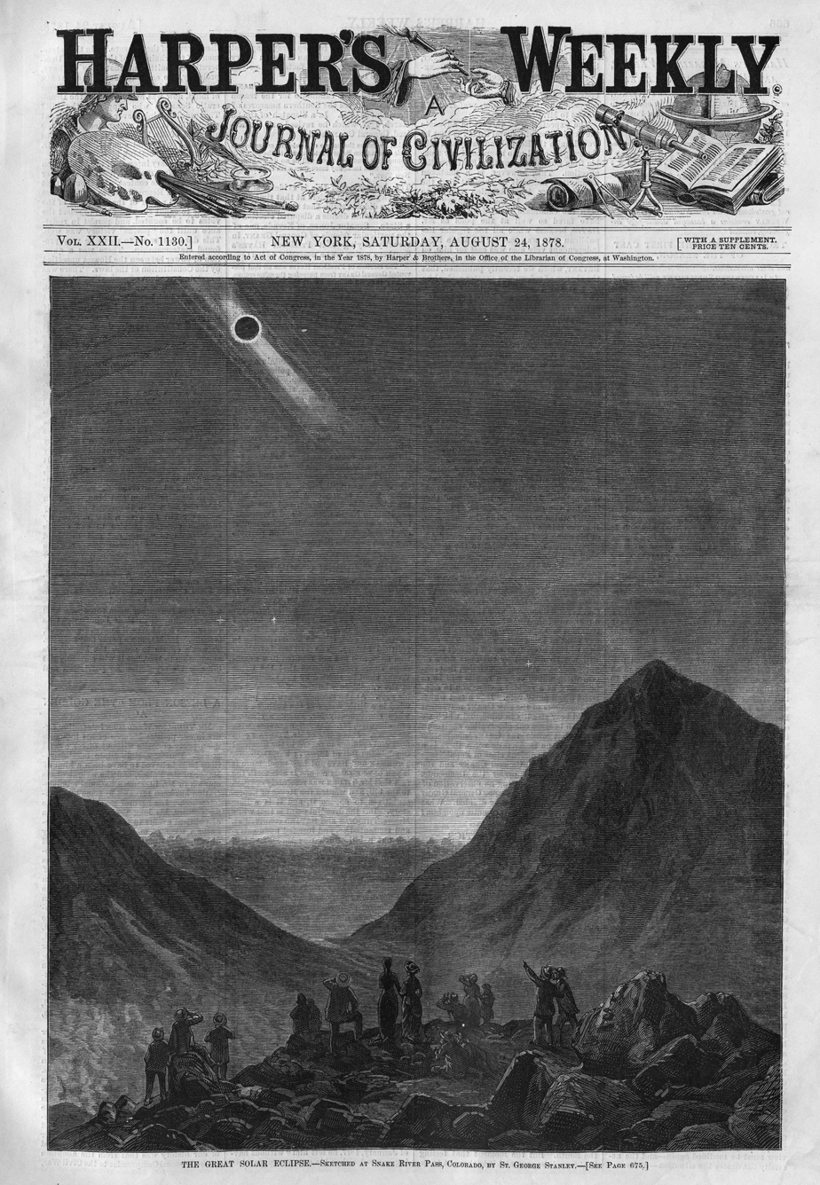
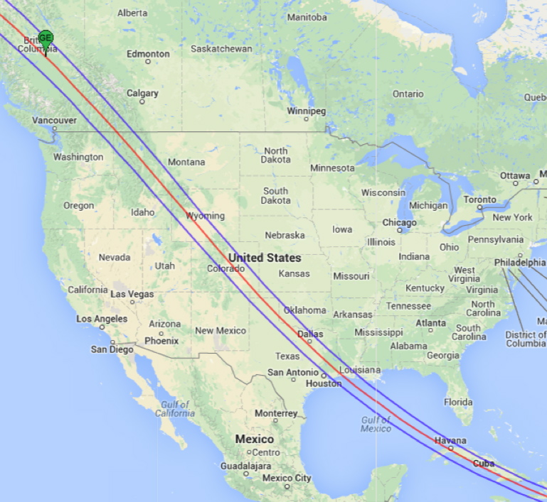
29 July 1878 – cross-country USA
“Eclipse Chasing” not yet in the contemporary lexicon, but seren-dipity (and the press) sparked viewing opportunites for many.
Snake River Pass, Colorado USA
(2,750 m AMSL, 2m 52s totality)

Slide 27
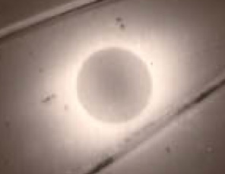
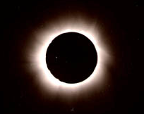
Though coronal photography was proving itself throughout the late 1800’s as an enabling investigative technology. E.g.:
TSE 1889
TSE 1893
But, with the expanding quest for more (imaging) data…
“The operation of 20 or 30 {photographic} instruments by hand is out of the question, even if human nerves were infallible.”
– David Peck Todd 1897 (Astrophysical Journal, 5, 318)

Slide 28
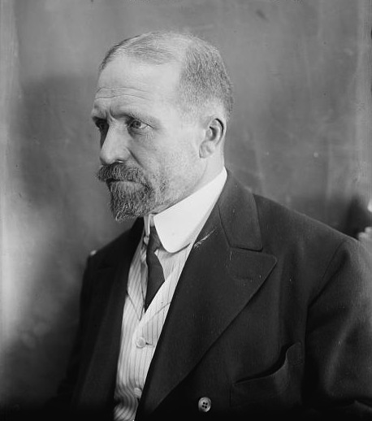
Prof. David P. Todd (1855 – 1939)
USNO (1875 – 1878)
USNAO (1878-1881)
Amherst College (1881-1917+)
Organized/Lead TSE RESEARCH EXPEDITIONS:
Chief Astronomer at Lick Observatory @ 1882 Transit of Venus
29 JUL 1878 | New England Expd. To Texas
19 AUG 1887 | U.S. Expd. To Japan
22 DEC 1889 | West Africa
09 AUG 1896 | Amherst Exps. to Japan
28 MAY 1900 | Lowell Expd. to Tripoli
18 MAY 1901 | Amherst Expd. to Dutch East Indies
30 AUG 1905 | Tripoli
21 AUG 1914 | Amherst Expedition to Russia
08 JUN 1918 | Florida
29 MAY 1919 | Brazil/Argentina

Slide 29
Prof. David P. Todd (1855 – 1939)
In “On the Use of Electric Telegraph During Total Solar Eclipses”, The Observatory, 4, 198 (1881)
“One of the most intractable considerations in the study of the Sun and its surroundings lies in the small amount of time which is availble for the prosecution of that study.
“Most of the phenomena in the neighborhood of the sun can be investigated only when the sun itself is hidden during eclipse.
“If we suppose a single observer to be prepared for the observation of all total solar eclipses in a century, … the entire amount of time … will not differ much from an hour.
We may be sure, then, of the expediency of any scheme whereby the rare moments of these {total solar} eclipses may be utilized to their utmost extreme.”
Notes:
Telegraph lines in the paths of eclipses in the 1880s.

Slide 30
Prof. David P. Todd (1855 – 1939)
In “Automatic Photography of the Corona”, The
Astrophyscial Journal, 5, 319 (1897)
“My attention was first called to this subject… on the return of the government expeditions to Washington {from TSE 1887 in Shirakawa, Japan}. Excellent photographs had been obtained, but the number of instruments available … and photo-graphs obtainable by hand-exposure struck me as
exceedingly meager for an occasion… like a total eclipse of the Sun.”
“the money value of a single second is often hundreds of dollars”
{inflation: $100 from 1878 to 2014 → $ 2300 in RY2014 $ USD}
“this would be true even if the human mechanism remained unperturbed under the strain of totality; but sad experience shows its frailty… no matter how constantly rehearsed.”
Notes:
Bureau of Labor Statistics CPI from 1931 to 2014. Historical study by Robert Sahar (Oregon State Univ) 1665 to 1912 .

Slide 31
Prof. David P. Todd (1855 – 1939)
The “father” of automatic eclipse photography
Inventor of the “Eclipse Commutator”
In “Automatic Photography of the Corona”, The
Astrophyscial Journal, 5, 319 (1897)
{regading TSE 1889, West Africa} “The operation of 20 or 30 instruments by hand is out of the question, even if human nerves were infallible
to accomplish the desired end by mechanical devices…”
“a complete pneumatic system of automatic instruments* had been
worked out and constructed {and} demonstrated for the 1st time
practicable for a few observers in the field .” – D. P. Todd (ApJ, 5, 319)
* “The principle of the device was a pneumatic commutator which exercised perfect and automatic control over a score of telescopes
and cameras for different purposes.” – M. T. Bingham (P.A., 33, 631)
Notes:
Bureau of Labor Statistics CPI from 1931 to 2014. Historical study by Robert Sahar (Oregon State Univ) 1665 to 1912 .

Slide 32
The Pneumatic Commutator and Photographic Battery of Eclipse Instruments
as mounted at Cape Ledo, Africa for TSE 1889
• 23 (mostly photographic) instruments
• ALL co-mounted and co-aligned on a single
polar axis drive
• Using punched-paper “music roll” with
digital program to control camera shutters, aperture wheels, plate mechanisms, etc.
• Using player pump-organ and pneumatic
tubes for air pressure delivery and operation
• worked perfectly – but: “unfortunately an accident of the day in the shape of an un-timely cloud precluded totality-pictures”
– D. P. Todd (ApJ, 5, 319)
Notes:
Bureau of Labor Statistics CPI from 1931 to 2014. Historical study by Robert Sahar (Oregon State Univ) 1665 to 1912 .

Slide 33
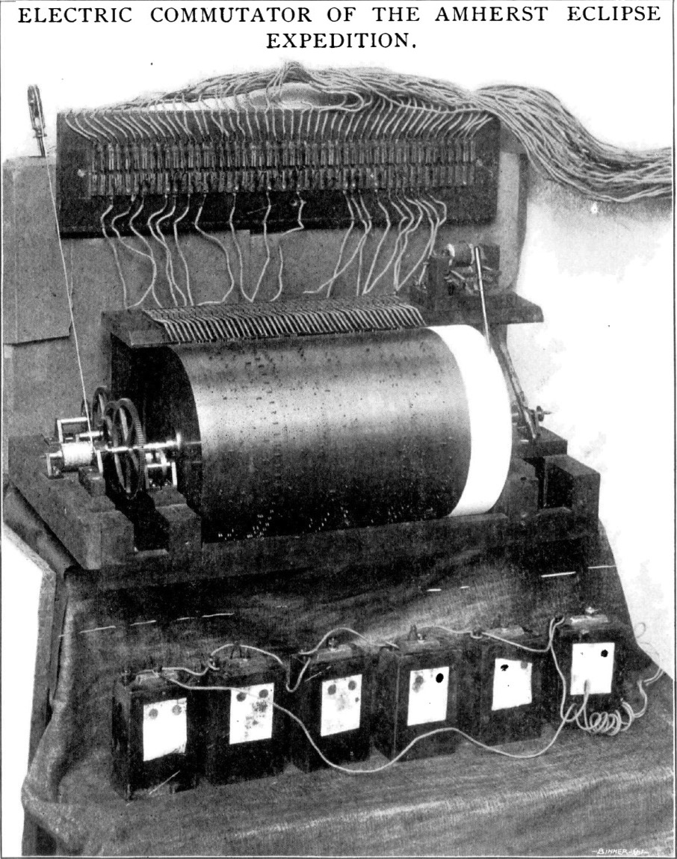
Prof. David P. Todd
• TSE 1896 (Japan):
Pneumatic system replaced
by electrical.
Pipes → Wires
Valves → Relays/Actuators
Simplified construction
and operation.
“perfectly competent to op- erate any number of eclipse
Instruments… accurately,
positively & makes a time
record of every automated
movement.”
Notes:
Bureau of Labor Statistics CPI from 1931 to 2014. Historical study by Robert Sahar (Oregon State Univ) 1665 to 1912 .

Slide 34
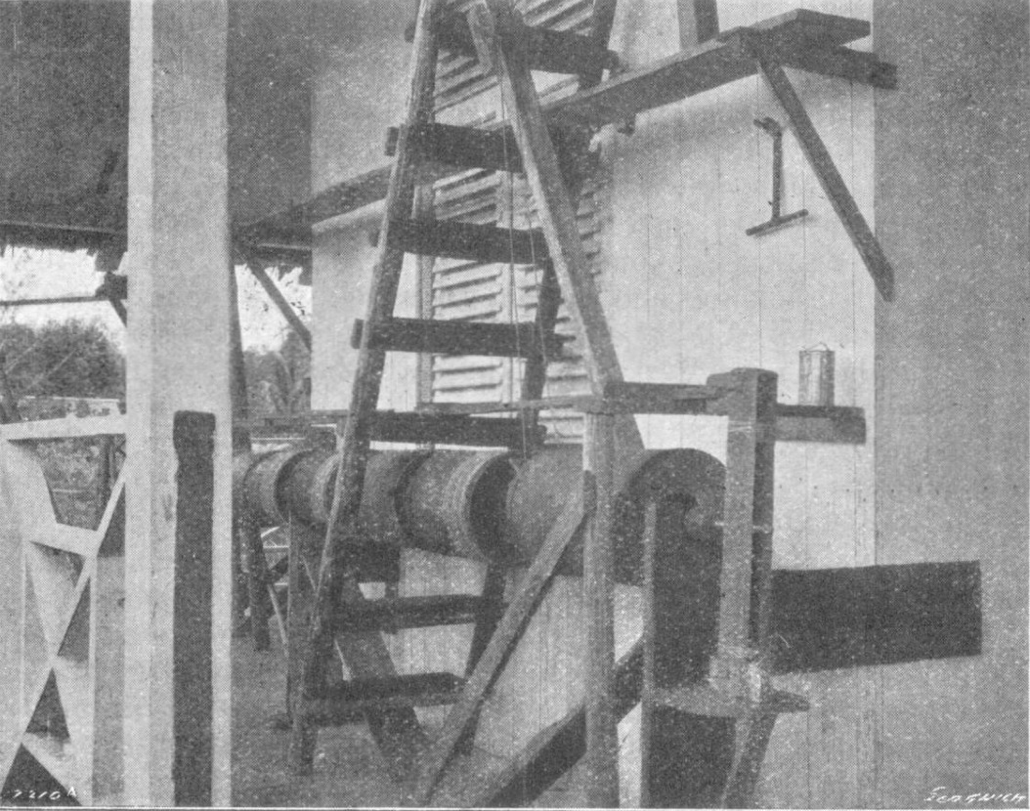
TSE 1901 (6m 20s; Sinkep) and the Mechanical Commutator
“The Amherst Eclipse Expedition… of 1901 led rather unexpectedly to the devising and construction of a modified type of commutator for operating eclipse instruments automatically.”
- JBAA, 12, 169 (1902)
Notes:
Bureau of Labor Statistics CPI from 1931 to 2014. Historical study by Robert Sahar (Oregon State Univ) 1665 to 1912 .

Slide 35
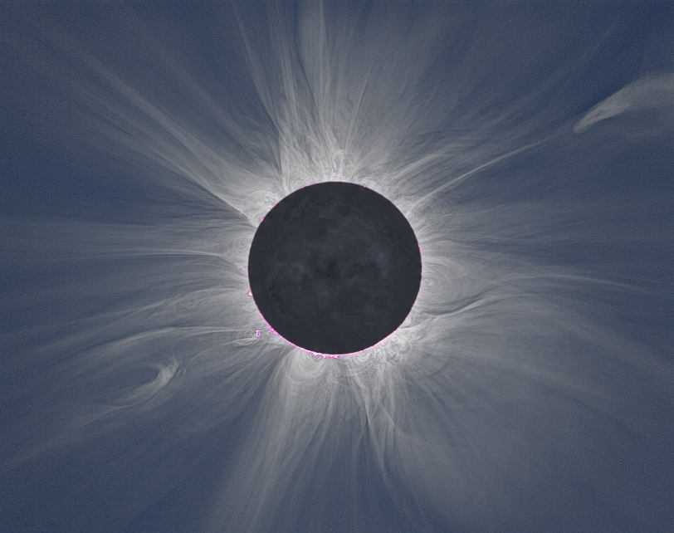
Prof. David P. Todd
“Fifty years have now elapsed since the Sun’s corona was first daguerreotyped… it {is} an open question whether … wet-plate pictures of the corona will ever be surpassed … except by the adoption of some device for reducing the actinic effect of the innermost corona.”
– MNRAS, 61, 531 (1901)
TODAY (163 years since…):
• High Dynamic Range
Imaging with Electro-
Optical Detectors.
• Digital Image Combination
for High Signal-to-Noise
Recovery
• Numerical Spatial-Filtering
in Image Post-Processing
E.g., TSE 2013, M. Druckmuller, M2V Project
Notes:
Obviates halation otherwise oblitterating detail

Slide 36
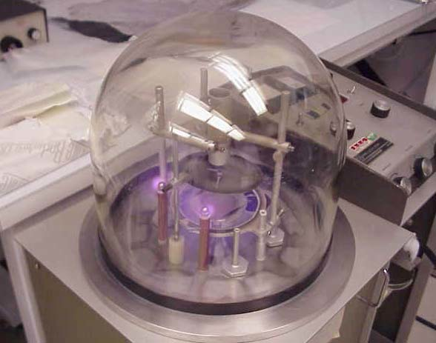
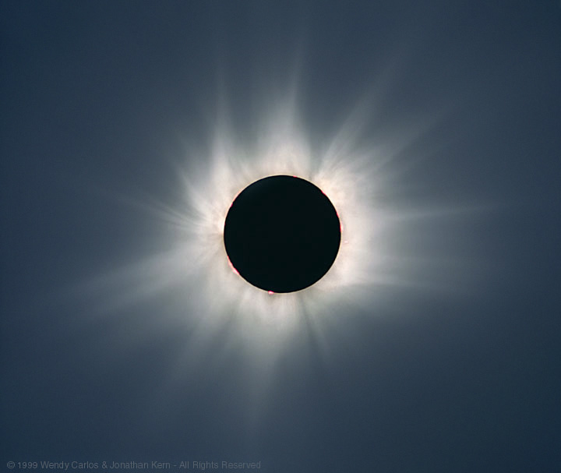
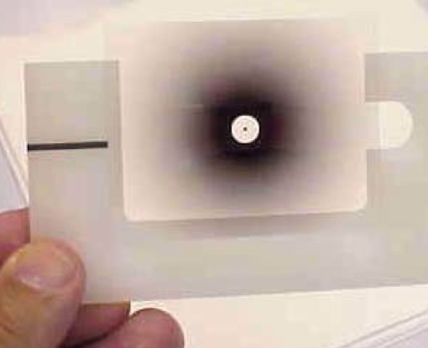
Prof. David P. Todd
“Fifty years have now elapsed since the Sun’s corona was first daguerreotyped… it {is} an open question whether … wet-plate pictures of the corona will ever be surpassed … except by the adoption of some device for reducing the actinic effect of the innermost corona.”
– MNRAS, 61, 531 (1901)
Circa 1970 – 1990 (film imaging):
• Radial deposition on glass substrate
filters
• Transmissivity
matching average
coronal radial
brightness profiles
• Mounted in
image plane
E.g., TSE 1999, W. Carols & J. Kern
Notes:
Obivates halation otherewise oblitterating detail

Slide 37
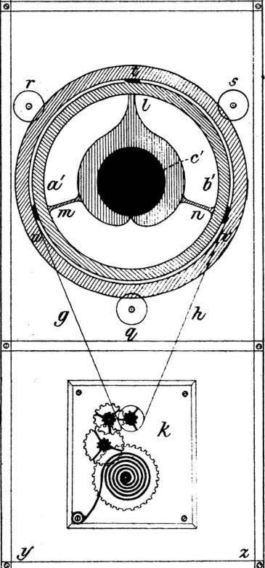
Prof. David P. Todd
• Also, designed the 1st radial gradient
(focal plane) “filter”!
“On a Modified Form of the Revolving Occulter
for Adapting the Exposure of the Sun’s Corona
to it’s Actinic Intensity at All Distances from
the Moon’s Limb.”
– MNRAS, 61, 531 (1901)
“Fifty years have now elapsed since the Sun’s
corona was first daguerreotyped… it {is} an
open question whether … wet-plate pictures of
the corona will ever be surpassed … except by
the adoption of some device for reducing the
actinic effect of the innermost corona.”
Notes:
Obivates halation otherewise oblitterating detail

Slide 38
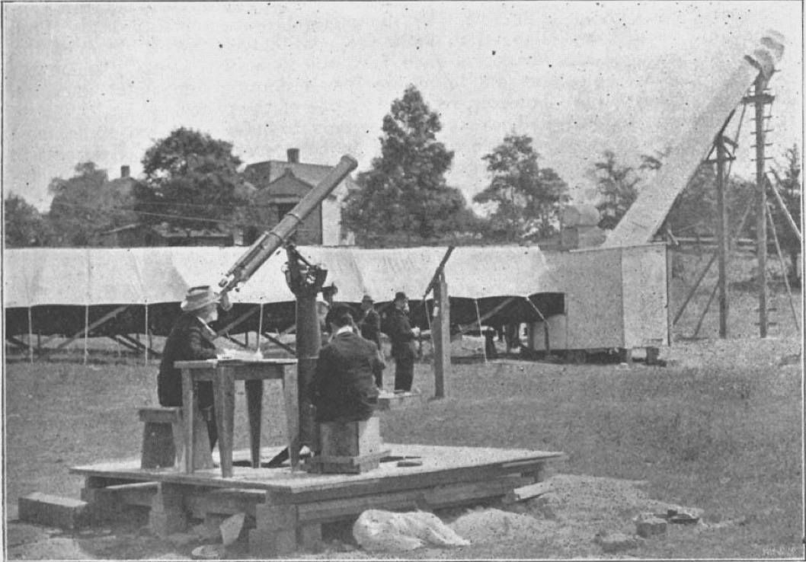
Intentionally “Chasing” the Moon’s shadow INTO the “path of totality” is a relatively new endeavor in the course of human history.
28 May 1900
Smithsonian
Institution
Expedition
Wadesboro
North Carolina
USA
Goal: High
Resolution Photography:
Corona and
Intra-Mercurial Planets
The Age of “Big Glass”
and Big Plates
15-inch dia. Prime focus lunar disk image
38-foot FL telescope(this is the not the big one)
135-foot FL (f/135 lens) telescope under tent

Slide 39
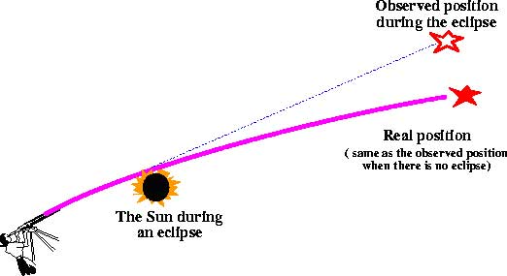
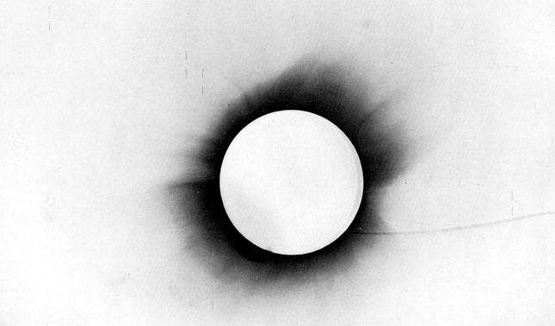
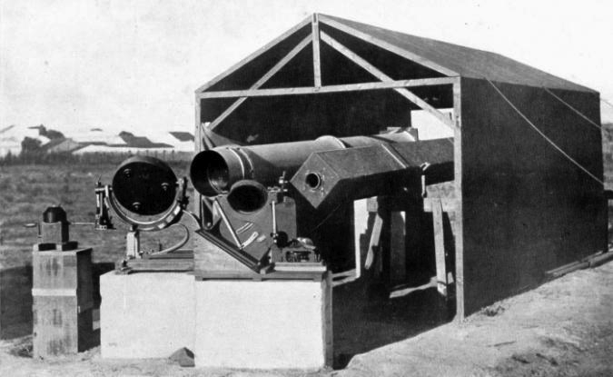
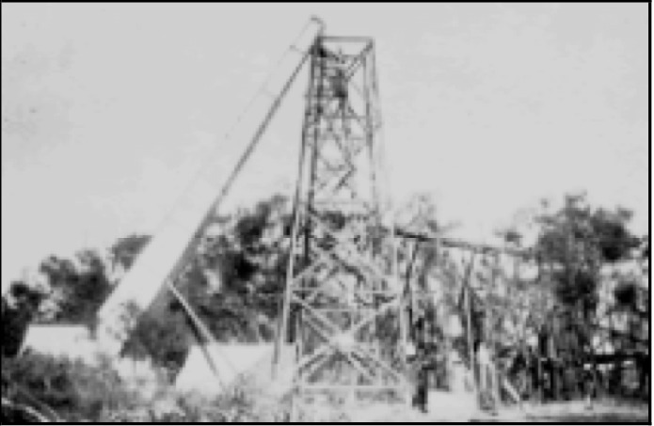
Intentionally “Chasing” the Moon’s shadow INTO the “path of totality” is a relatively new endeavor in the course of human history.
The Age of “Big Science”
TESTING/CONFIRMING
EINSTEIN’S GENERAL
THEORY OF RELATIVITY
Eddington Expedition May 29, 1919
Sobral Brazil
40 ft Camera Sep. 21, 1922
Eight Mile Beach
NW Australia

Slide 40
Egalatarian
Eclipse Chasing
In the
20th Century

Slide 41
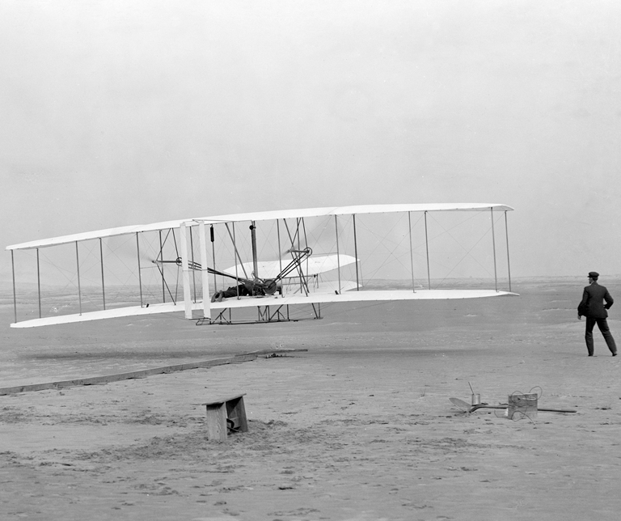
The Three Great Transformational Technologies Introduced in
The 20th Century Enabling “Egalitarian” Eclipse-Chasing
The Airplane
1903
• Easy, Rapid, Global Deployment
• Altitude: Rise Above Clouds
• Speed: Prolong Totality
• Contingency Mobility
2003
The Airplane

Slide 42
The Three Great Transformational Technologies Introduced in
The 20th Century Enabling “Egalitarian” Eclipse-Chasing
Aircraft also Provide a New, High-Altitude Vista for Observing Solar Eclips Phenomenon

Slide 43
The Three Great Transformational Technologies Introduced in
The 20th Century Enabling “Egalitarian” Eclipse-Chasing
Modern Rockets
Weather Monitoring &
Informed Forecasting
Global Positioning &
Precision Navigation
Instantaneous Global
Telecommunications
1926
ISRO Eutelsat W2M
Enabled Deployment of Space Assets
(increasing reliant on micro-electronics)

Slide 44
The Three Great Transformational Technologies Introduced in
The 20th Century Enabling “Egalitarian” Eclipse-Chasing
Space Assets also Provide a “New View” of SE Impacts on the Earth
TSE 2003 - Sun Low in Sky TSE 1999 - Sun High in Sky

Slide 45
The Three Great Transformational Technologies Introduced in
The 20th Century Enabling “Egalitarian” Eclipse-Chasing
The Transistor
THE TRANSISTOR – December 16, 1947
1947
Shockley, Bardeen, Brittan
1956 Nobel Prize in Physics
Basis for all Micro-Electronic (and “Consumer”) Devices to Follow

Slide 46
The Three Great Transformational Technologies Introduced in
The 20th Century Enabling “Egalitarian” Eclipse-Chasing
2014
1947
Imaging Detectors
Micro-Processors
consumer (eclipse-chaser) products
The Transistor
Umbraphilic computational capabilities for:
• High-Precision Eclipse Ephemerides and Circumstances • Mapping & Visualization Tools
• Autonomous Camera Control and Data Acquisition
• Image Reduction, Calibration, Processing & Analysis

Slide 47
Early 1970’s – Transformational Socio-Economic Umbraphilic Events Spawning the “MODERN” Age Eclipse-Chasing
1972 – 1ST Commercial Eclipse Cruise
TSS Olympia
800 PAX, 900 mi. e of NY
Phil Siegler Bob Little
“A floating scientific hotel…”
Onboard photos courtesy of Bill Kramer

Slide 48
Early 1970’s – Transformational Socio-Economic Umbraphilic Events Spawning the “MODERN” Age Eclipse-Chasing
1973:
2nd Commercial Eclipse Cruise
HMS Canberra, 3000 PAX NW African Coast
7+ minute Pro/Amateur Expedition(s) to NW Africa
Concorde used 1h 13m totality
supersonic eclipse chase

Slide 49
Early 1970’s – Transformational Socio-Economic Umbraphilic Events Spawning the “MODERN” Age Eclipse-Chasing
1974 – 1ST Commercial Eclipse Flight
Ansett Airlines B-727
Launch: Perth, Australia
Onboard photos courtesy of Wendy Carlos

Slide 50
The New Millenium
What a difference a century makes!
Turn of the 20th Century Turn of the 21st Century
(But: ‘The “Moore” things change, the more they stay the same’…)
Despite Technological Advances:
A TOTAL Solar Eclipse is arguably remains THE most impressive and awe inspiring
re-occurring natural phenomenon that humans can witness
The MOST viscerally dramatic and dynamic of ALL predicatble celestial events

Slide 51
Contemporary
Eclipse Chasing
a.k.a.
“UMBRAPHILIA”

Slide 52
WHO CHASES SOLAR ECLIPSES?
The Demographics of Umbraphillia
http://www.misterpoll.com/polls/596222/
206 Responses (at time of compilation)
“DO YOU CONSIDER YOURSELF AN ECLIPSE-CHASER?”
149 YES
57 NO

Slide 53
“WHAT PART OF THE PLANET DO YOU CONSIDER HOME? ”

Slide 54
ECLIPSE-CHASER “EXPERIENCE”
The Demographics of Umbraphillia
http://www.misterpoll.com/polls/596222/
TOTALITY BY THE “NUMBERS”:
• # TSE’s SEEN/ATTEMPTED
• AGE 1st TSE SEEN
• CURRENT AGE
• # YEARS CHASING ECLIPSES

Slide 59
ECLIPSE-CHASER “EXPERIENCE”
The Demographics of Umbraphillia
http://www.misterpoll.com/polls/596222/
CHASING OTHER SHADOWS BY THE “NUMBERS”:
• # ANTUMBRAL SHADOWS (ANNULARS)
• PENUMBRAL SHADOWS (PARTIALS)

Slide 63
DEGREE OF “ADDICTION”
The Demographics of Umbraphillia
http://www.misterpoll.com/polls/596222/
TOTAL UMBRAL EMERSION
• INITIAL REACTION (GETTING HOOKED)
• DEPTH OF COMMITMENT / PASSION

Slide 66
AREAS OF INTEREST
The Demographics of Umbraphillia
http://www.misterpoll.com/polls/596222/
THE MANY FACETS OF UMBRAPHILIA*
• SOMETHING FOR EVERYONE…
• PHOTOGRAPHY/VIDEOGRAPHY
• PROFESSIONAL “vs.” RECREATIONAL
• PUBLICATION

Slide 69
WORK/PROFESSION IS RELATED TO ECLIPSE INTERESTS:
ECLIPSE CHASERS: 28.2%
NON ECLIPSE CHASERS: 4.0%
PROFESSIONAL OR RECREATIONAL S.E. RELATED ACTIVITIES
% PERON INVOLVEMENTS ECLIPSE CHASER NON-ECL CHASER
PROF RECR NONE PROF RECR NONE
IMAGING/DATA ANALYSIS 8.7 58.4 32.9 0.0 40.4 59.6
S.E. RELATED STUDIES 8.7 41.6 49.7 0.0 21.1 78.9
OBSERVATION PLANNING 10.1 53.0 36.9 0.0 36.8 63.2
TRAVEL ORGANIZING 8.1 25.5 66.4 1.8 15.8 82.5
EDU/PUB OUTREACH 12.8 41.6 45.6 3.5 35.1 61.4

Slide 71
PERSONAL PREFERENCES
The Demographics of Umbraphillia
http://www.misterpoll.com/polls/596222/
TSE OBSERVING:
• SOLITUDE vs. A SOCIAL EVENT
• VENUE: LAND vs. SEA vs. AIR

Slide 76
PLANNING AND PREPATIONS
The Demographics of Umbraphillia
http://www.misterpoll.com/polls/596222/
• ACTIVITIES INVOLVEMENT
• SITE SELECTION CRITERION

Slide 78
PLANNING FACTOR IMPORTANCE (VALUE = 0-100)
ECLIPSE CHASER NON ECLIPSE CHASER
RANK CRITERION VALUE CRITERION VALUE
1 WEATHER 65.3 WEATHER 58.2
2 CONTINGENCY 44.3 DURATION 44.2
3 DURATION 42.3 BUDGET 42.1
4 SITESEEING 42.1 CONTINGENCY 39.8
5 BUDGET 37.8 GEOPOLITICS 34.8
6 GEOPOLITICS 37.4 SITESEEING 33.3
PERCENTAGE PASS ON SHORT DURATION
ECLIPSE CHASER: 24.2 %
NON ECLIPSE CHASER: 47.4 %

Slide 79
PLANNING AND PREPATIONS
The Demographics of Umbraphillia
http://www.misterpoll.com/polls/596222/
• PLANNING FOR FUTURE ECLIPSES

Slide 82
55.0%
planning
NA
55.0%
overall
NA
12.1%
planning
NA
55.0%
Overall
NA
7.4%
planning
ASIA+
AUST+
PAC
15.4%
overall
ASIA+
AUST+
PAC
0.7%
planning
SA
0.7%
overall
SA
20.1%
planning
EUR
29.9%
overall
EUR

Slide 83
PLANNING AND PREPATIONS
The Demographics of Umbraphillia
http://www.misterpoll.com/polls/596222/
• IN SUMMARY…

Slide 85
COMMENTS BY UMBRAPHILES
ON SOLAR ECLIPSE CHASING
“It defies my understanding why a great many people who enjoy this activity seem to feel the need to adopt a label of being some kind of eccentric nut called an ‘umbraphile’ or some such.”
UMBRAPHILE*: (n.) 1. shadow lover (2). one who is addicted to the glory and majesty of total solar eclipses.
Etymology: Latin umbra (shadow) + Greek philos (loving)
N.B.: The traverse of the lunar umbra heeds no national boundares, and neither do umbraphiles – hence the mixed etymological roots.
*Ref.: Schneider, 2006, “There (70°S @ 10,177m) and Back Again: An Umbraphile’s Tale” in Astronomical Data and Software Systems XV, ASP Conference Series, 351, 35

Slide 86
COMMENTS BY UMBRAPHILES
ON SOLAR ECLIPSE CHASING
“It is the most spectacular sight
one can witness on this planet ”
– 9 TSEs, age 63, North America

Slide 87
COMMENTS BY UMBRAPHILES
ON SOLAR ECLIPSE CHASING
“Most amazing natural phenomena I have experienced, and find it hard to believe that anything else would top it”
– 2 TSEs, age 63, Australia/Pacific

Slide 88
COMMENTARY ON
SOLAR ECLIPSE CHASING
“I think eclipses are beautiful
things to experience.
This is a perfectly adequate and moderate reason for chasing them.”
– 8 TSEs, age 55, Europe

Slide 89
COMMENTS BY UMBRAPHILES
ON SOLAR ECLIPSE CHASING
“Viewing a Total Solar Eclipse is not a matter of life and death,
it is far more important than that.”
– 11 TSEs, age 43, Europe

Slide 90
COMMENTS BY UMBRAPHILES
ON SOLAR ECLIPSE CHASING
“I am not a spiritual/religious person,
but a TSE connects me with the
solar system/universe
in a way nothing else can.”
– 3 TSEs, age 50, North America

Slide 91
COMMENTS BY UMBRAPHILES
ON SOLAR ECLIPSE CHASING
“Eclipse viewing is a peak life experience and truly addicting.
One visits exotic locations otherwise not seen. Enjoy company and friendship
of other umbraphiles.”
– 7 TSEs, age 58, North America

Slide 92
COMMENTS BY UMBRAPHILES
ON SOLAR ECLIPSE CHASING
“Total eclipses are a gift to humanity.
It would be an insult to the Will of Fate to refuse to partake in something which is,
on all levels, so uniquely - and serendipitously - human. ”
– 12 TSEs, age 51, North America

Slide 93
COMMENTS BY UMBRAPHILES
ON SOLAR ECLIPSE CHASING
“Excellent combination of my interests: astronomy (focus on transient phenomena),
photography, travel, computing,
astronomy outreach.”
– 13 TSEs, age 66, Australia/Pacific

Slide 94
COMMENTS BY UMBRAPHILES
ON SOLAR ECLIPSE CHASING
“I love eclipses ... both a ‘once in a lifetime’ and a ‘bucket list’ event. A total body experience. I have recommended to literally thousands of people … that they pursue and
observe at least one TSE in their lifetimes.”
- 1 TSEs, age 58, North America

Slide 95
COMMENTS BY UMBRAPHILES
ON SOLAR ECLIPSE CHASING
“I don't consider myself religious,
but {TSE2012} was one of the most incredible experiences of my life
and I want to experience it some more. ”
- 2 TSEs, age 26, Australia/Pacific

Slide 96
COMMENTS BY UMBRAPHILES
ON SOLAR ECLIPSE CHASING
“The most spectacular event, natural or manmade, that a human could ever possibly hope to see.
No matter what we do or say, no one can ever change its happening or its phenomenae. …. special indeed!”
– 29 TSEs, age 67, North America

Slide 97
COMMENTS BY UMBRAPHILES
ON SOLAR ECLIPSE CHASING
“Better than sex”
– 17 TSEs, age 65, North America

